Slide 1
Road Accident
Data Analysis
Risk Factors: A Visual Narrative
1,610
1,610
23
50
Raw Records
Cleaned Records
Variables
US States
Source: Road Accident Dataset | Jan–Feb 2024 | 50 US States

Slide 2
About the Dataset
Dataset Background
Key Variables
This dataset contains 1,610 road accident records from across 50 US States, collected during January–February 2024. Each record captures the full accident context including weather, road type, driver demographics, vehicle details, and emergency response time. The dataset was synthetically generated to mirror real-world accident patterns and was used to practice data cleaning and visualization.
State:
50 US States
Weather Conditions:
Rainy, Sunny, Snowy, Foggy, Stormy
Road Conditions:
Dry, Wet, Muddy, Icy, Snowy
Light Conditions:
Daylight, Dawn, Dusk, Night
Type of Road:
Street, Highway, Rural, Urban, Freeway
Driver Age Group:
Teenager, Young Adult, Adult, Senior
Num Casualties:
Injuries per accident (0–5+)
Vehicle Speed:
Speed at time of accident
1,610
23
50
Jan–Feb 2024
Total Records
Columns
US States
Date Range

Slide 3
Data Cleaning Process
Missing: Weather Conditions
Missing: Road Width & Emergency Response Time
⚠ 149 out of 1,610 records (9.3%) had no weather data — critical for accident analysis.
⚠ 157 Road Width and 166 Emergency Response Time values were missing.
✔ Missing values filled with 'Unknown' to preserve the record without fabricating data.
✔ Filled with median values — median is the best fit for right-skewed distributions.
Missing: Type of Junction
Inconsistent Text Categories
⚠ 155 records (9.6%) were missing junction type, which affects accident type classification.
⚠ Text fields had mixed casing: 'rainy' vs 'Rainy', 'STREET' vs 'Street'.
✔ Filled with 'Unknown' — a neutral category that avoids biasing the distribution.
✔ Applied .strip().title() to standardize all categorical text values uniformly.
Missing: Speed Limit & Vehicle Speed
⚠ 153 Speed Limit and 177 Vehicle Speed values were blank — both numerical columns.
✔ Replaced with the median value (robust to outliers, avoids distorting the distribution).
Result: All 957 missing values resolved across 6 columns | No records dropped | All values now clinically valid

Slide 4
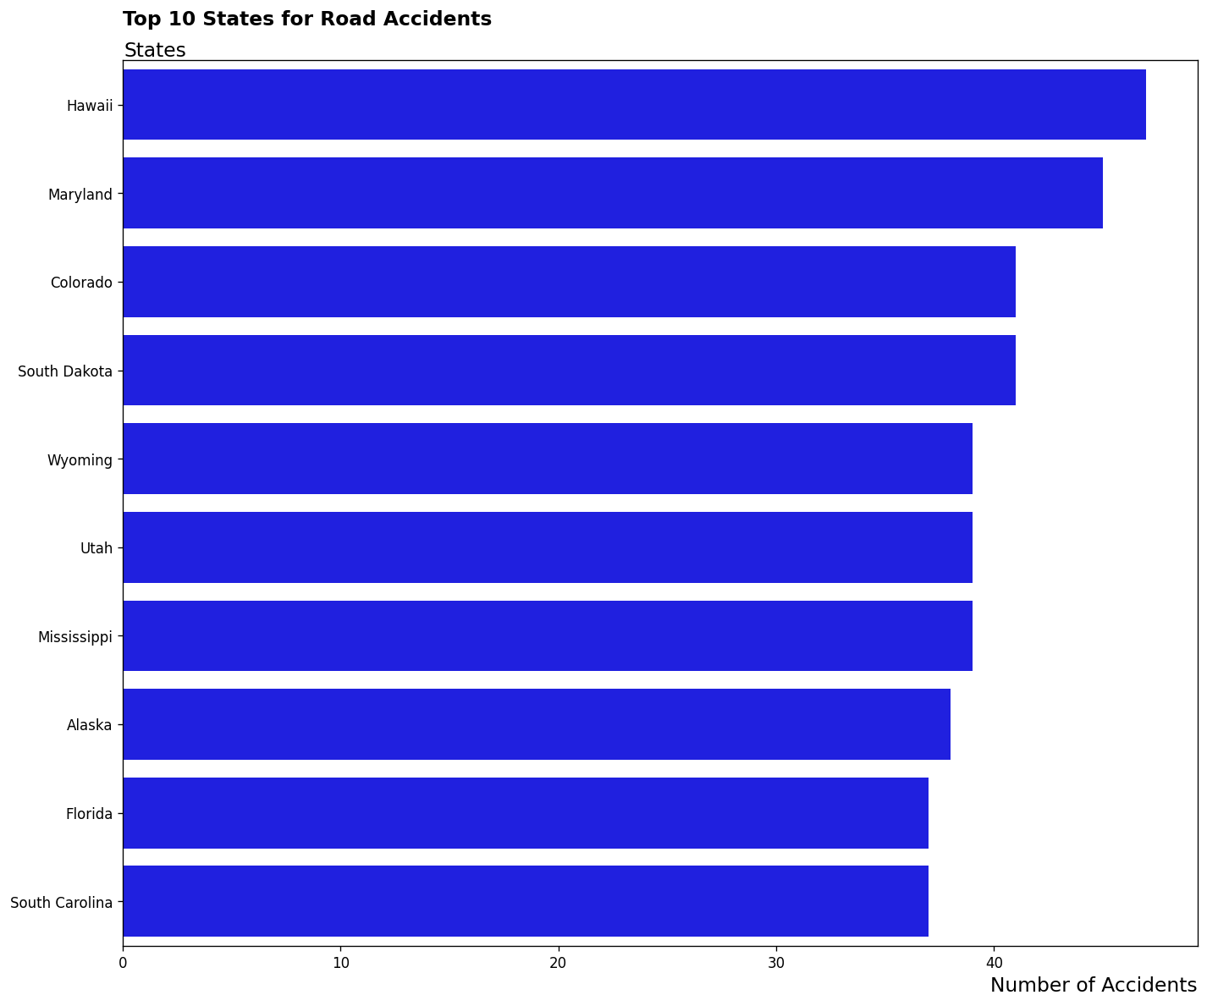
Visualization 1
Which States Have the Most Road Accidents?
Key Finding
Hawaii leads with 47 accidents, followed by Maryland (45). Isolating the top 10 states identifies regional hotspots where safety interventions are most needed. A large gap between the top state and others may indicate population size or reporting bias.

Slide 5
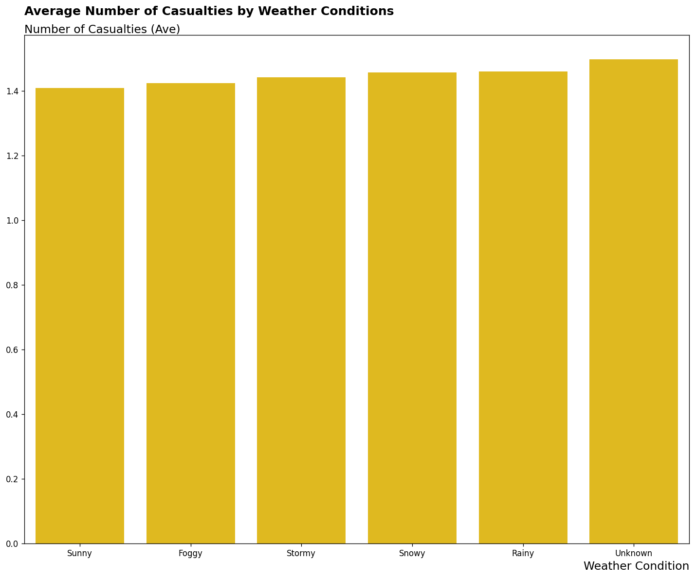
Visualization 2a
Does Weather Affect the Number of Casualties?
⚠ Misleading Encoding
Bar charts showing only the mean can be misleading. Stormy weather appears most dangerous — but hides whether this is driven by a few extreme events or a consistent trend. See Slide 6 (boxplot) for the full picture.

Slide 6
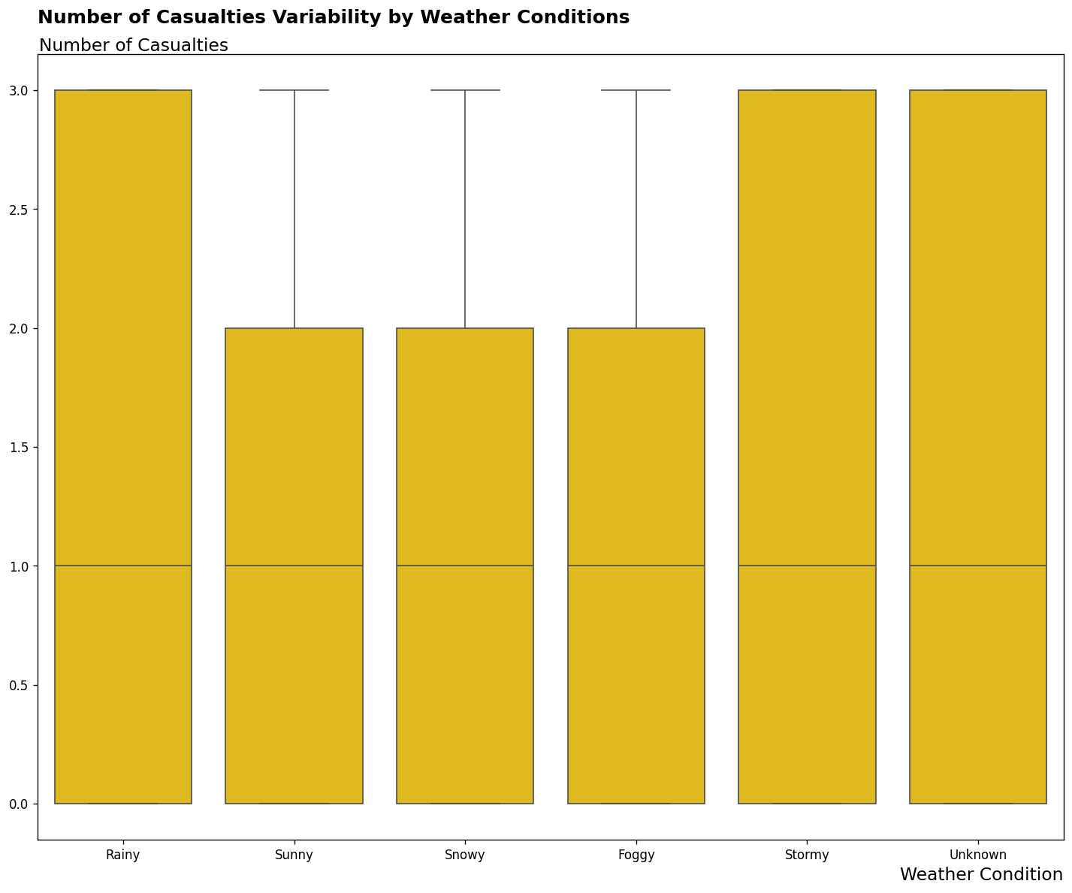
Visualization 2b
Casualties Vary Widely — Regardless of Weather
Key Finding
The boxplot reveals that casualties range from 0 to 3+ across ALL weather types. Weather conditions do not make individual accidents significantly more deadly. This prevents the viewer from mistaking the average for the full story.

Slide 7
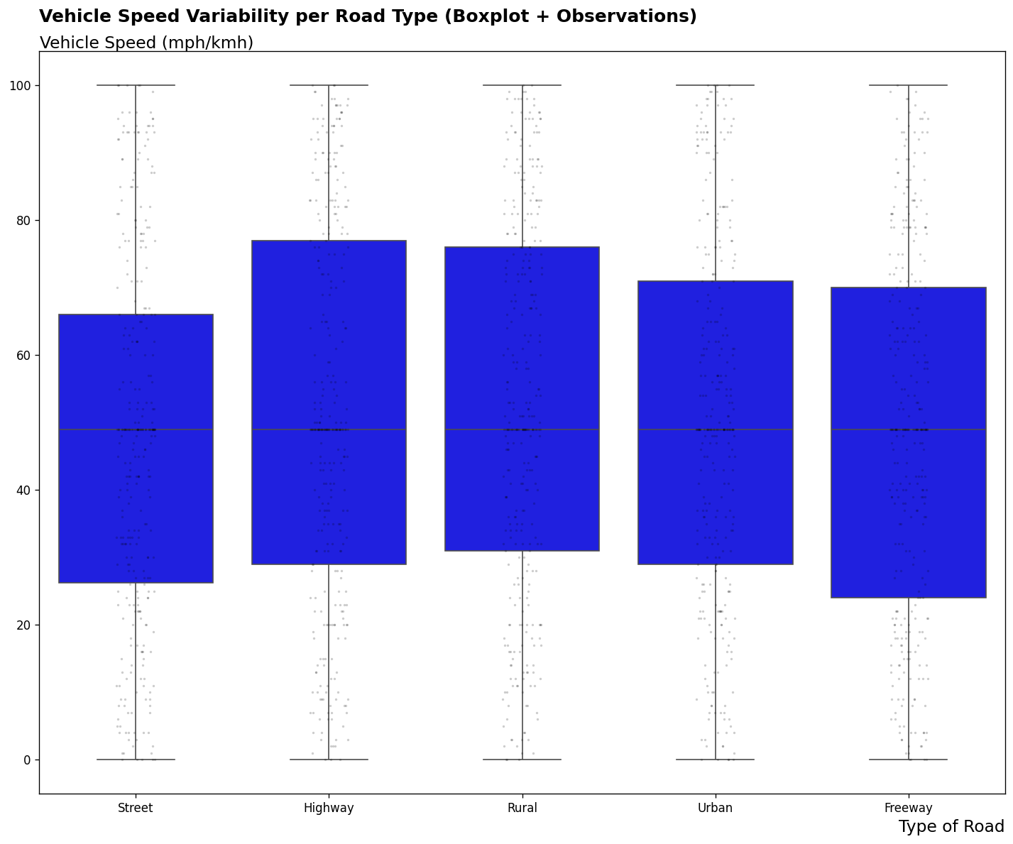
Visualization 3
Vehicle Speed Variability per Road Type
Key Finding
Highways have the highest median speeds — expected. Rural roads show surprisingly similar median speeds to Highways. Street (urban) speeds are the most consistent — likely due to traffic signals and congestion.

Slide 8
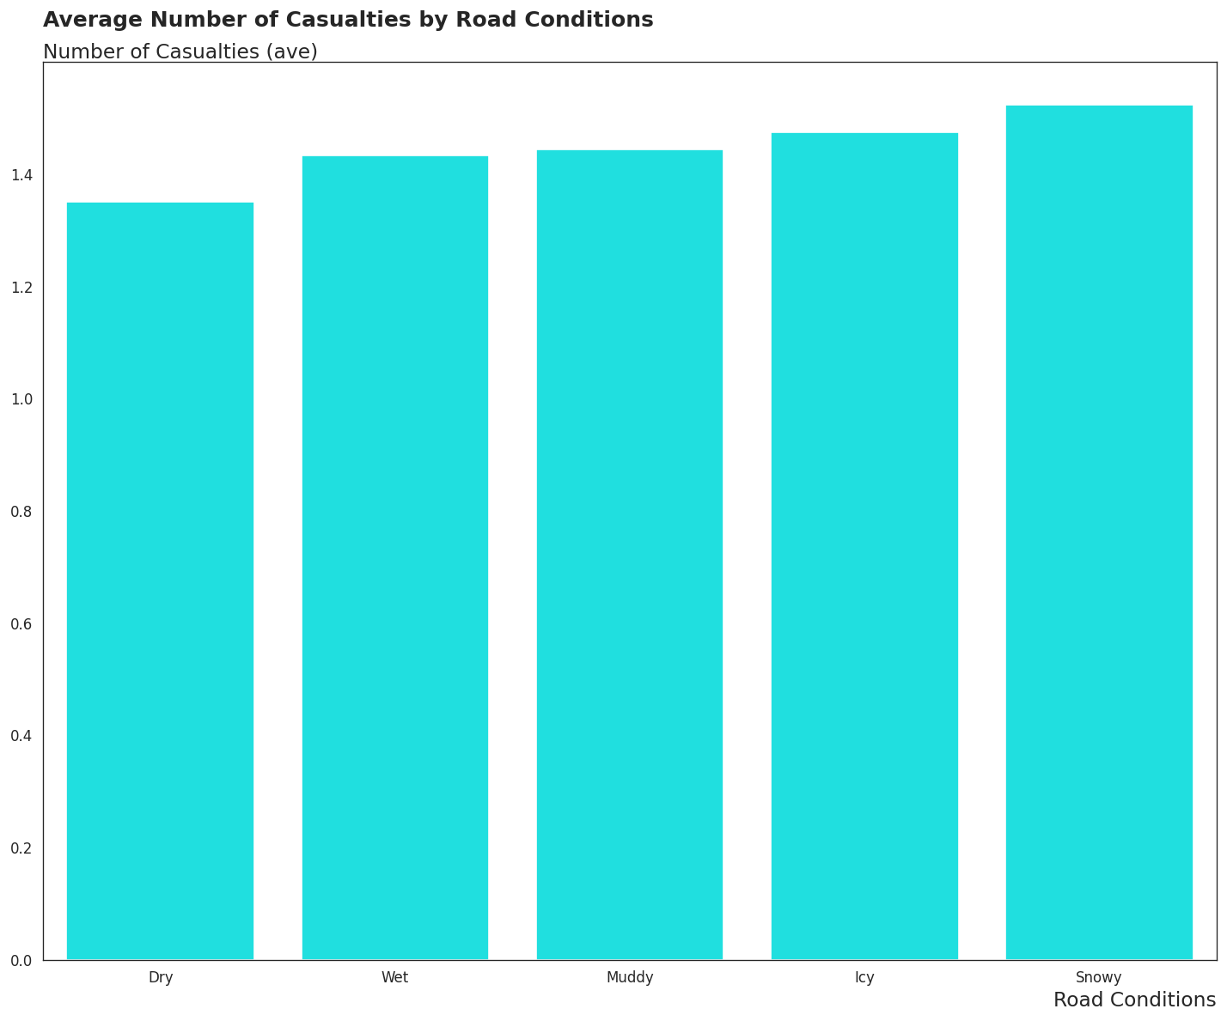
Visualization 4a
Road Conditions and Average Casualties
Trend
Casualties rise as road conditions worsen from Dry → Wet → Muddy → Icy → Snowy. Lower road friction directly corresponds to higher injury counts. Snowy and Icy roads represent the highest-risk conditions in the dataset.

Slide 9
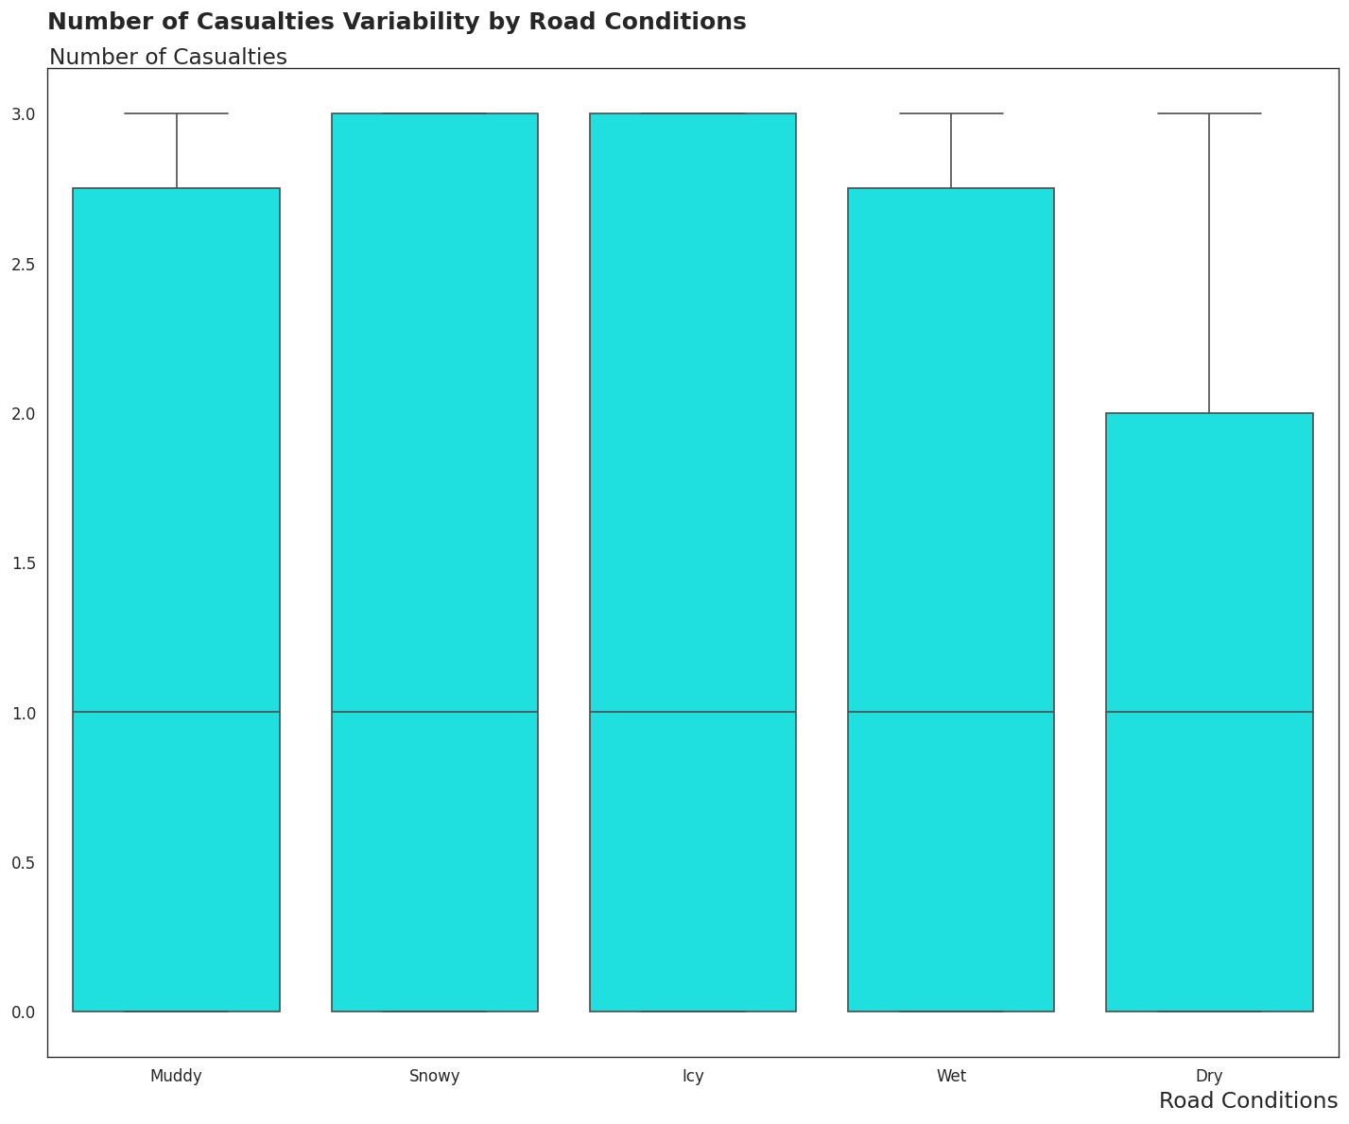
Visualization 4b
Casualties Variability by Road Conditions
Pattern
Each condition has a similar number of records — averages are comparable. Spread in the boxplot confirms the trend seen in the bar chart: icy/snowy roads produce both higher medians and more extreme outcomes.

Slide 10
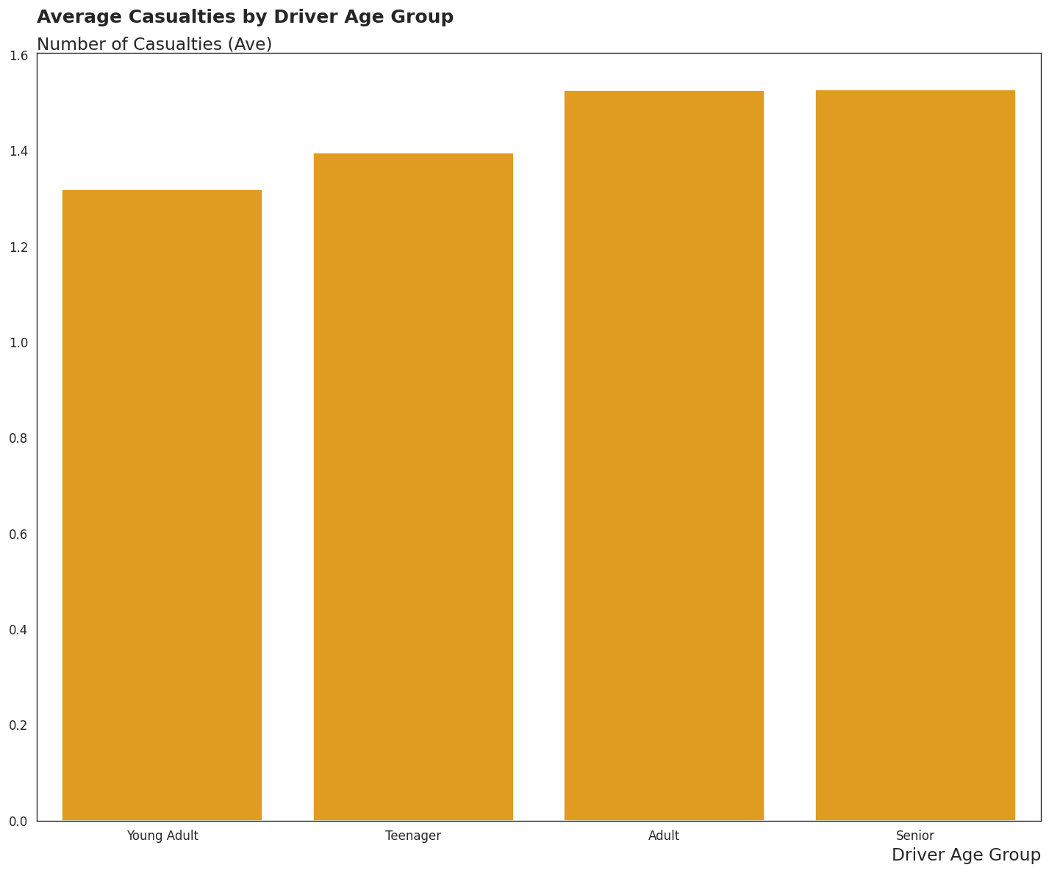
Visualization 5
Average Casualties by Driver Age Group
Trend
Clear upward trend from Teenager → Young Adult → Adult → Senior. Adult and Senior bars are very close in height — suggesting severity levels off once drivers reach maturity. Senior drivers produce the highest average casualties per accident.

Slide 11
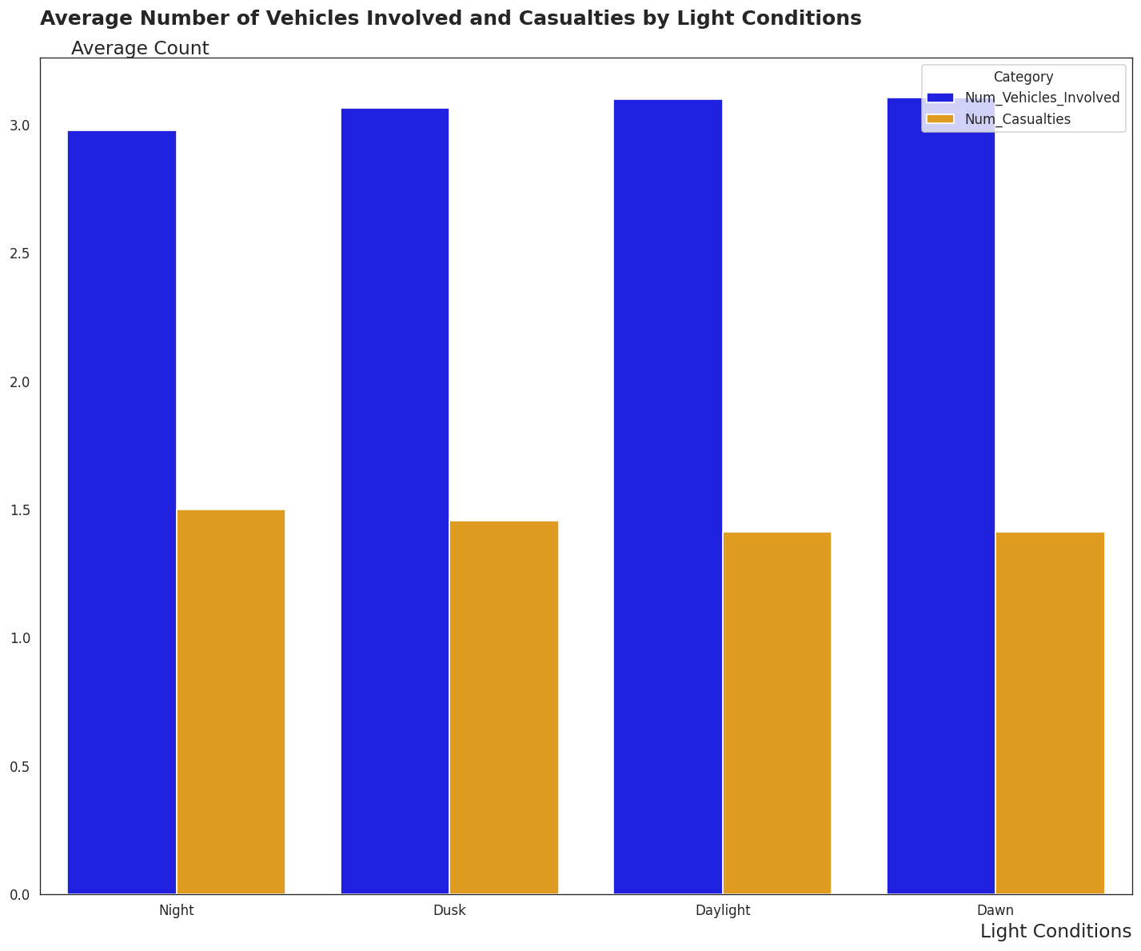
Visualization 6
Vehicles Involved and Casualties by Light Conditions
Key Finding
Night accidents involve fewer vehicles but result in higher casualties — increased severity in darkness. Daylight and Dawn see more vehicles involved but lower casualty rates. Across all conditions, vehicles involved ≈ 2× casualties — a consistent pattern.

Slide 12
Key Insights
What the data tells us about road accident risk
1 Geographic Hotspots
2 Weather ≠ More Deaths
3 Road Conditions Matter
Hawaii and Maryland lead with the highest accident counts, suggesting regional infrastructure or reporting differences.
Despite expectations, weather type doesn't significantly change casualty counts per incident — the full spread is similar across all weather.
Snowy and icy roads clearly produce more casualties on average. Lower friction = higher severity.
4 Night Drives = Danger
5 Age & Risk
6 Data Quality is Key
Night accidents involve fewer vehicles but more casualties per incident — low visibility amplifies severity.
Senior drivers are involved in the most severe accidents on average. Risk rises steadily from Teenager to Senior.
957 missing values across 6 columns were resolved using median imputation and text normalization before any analysis could begin.

Slide 13
Conclusion
What We Achieved
▸ Cleaned a real-world accident dataset: resolved 957 missing values across 6 columns using median imputation and text normalization
▸ Identified that weather affects accident frequency but NOT necessarily casualty severity per incident
▸ Established road conditions (Icy/Snowy) and light conditions (Night) as the clearest severity drivers
▸ Showed that bar charts showing averages can mislead — boxplots reveal the true spread
Road safety is preventable. Data-driven insights save lives.

